Slide 1

Artificial Intelligence BAI402
Balaji Vijaykumar B.E.,(NIE), M.Tech.,(SJCE)
Assistant Professor, Department of CS&E-AIML
The National Institute of Engineering, Mysuru
(Former Research & Development Engineer @ Philips R&D)
(Former Software Engineer @ Accenture)

Slide 2

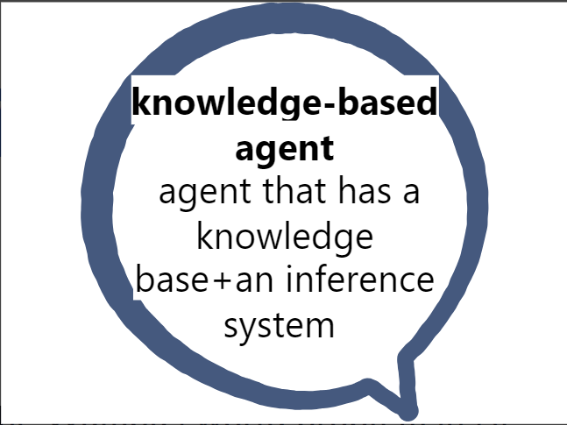
The Wumpus world problem
The Wumpus world problem depicts the value of a knowledge-based agent and the interpretation of that knowledge with the help of reasoning and planning.
Inference:
a conclusion reached on the basis of evidence and reasoning

Slide 3
What is the Wumpus world problem in AI?
Wumpus World Overview: The Wumpus World is a simple, yet powerful, grid-based environment used to demonstrate various aspects of intelligent agent design and decision-making. It is significant because it provides a controlled setting to study how agents perceive their environment, plan actions, and handle uncertainty.

Slide 4
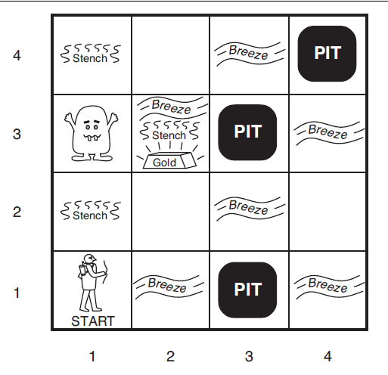
What is the Wumpus world problem in AI?
Problem Statement: In the Wumpus World, the agent's objective is to locate the gold and return to the starting point without encountering deadly pits or the Wumpus. The challenge lies in navigating an environment with hidden dangers and limited sensory information.
Actions: (Performed by Actuators)
Left turn,
Right turn
Move forward
Grab
Release
Shoot.
Performance Measure
+1000 points: Agent exits the cave with the gold.
-1000 points: Agent is eaten by the Wumpus or falls into a pit.
-1 point: Penalty for each action taken.
-10 points: Penalty for using an arrow.
Why negative grading?
Stench: Indicates the Wumpus is in an adjacent room.
Breeze: Indicates a pit is in an adjacent room.
Glitter: Indicates the gold is in the current room.

Slide 5
What is the Wumpus world problem in AI?
Environment: The environment is a 4x4 grid with rooms that can contain pits, the Wumpus, and gold. It is static and fully observable.
Sensors: The agent perceives its environment through a set of sensors that detect:
Stench: Indicates the Wumpus is in an adjacent room.
Breeze: Indicates a pit is in an adjacent room.
Glitter: Indicates the gold is in the current room.
Task Environment Properties:
Observable: The environment is partially observable as the agent only has information about its immediate surroundings.
Deterministic: The environment is deterministic because the outcome of an action is predictable (moving to an adjacent room, picking up gold, shooting an arrow).
Episodic: The environment is sequential because the agent's actions are dependent on previous states and percepts.
Static: The environment is static as it does not change while the agent is deliberating. Only the agent’s actions alter the environment.
Discrete: The environment is discrete in terms of the number of possible actions (move, grab, shoot) and percepts (stench, breeze, glitter)

